Slide 1
VisioGraphic Resume
(Project Presentation)
Team Members:
-Surya kiran (ID:01452383)
-Satish Kumar Tiriveedhi(ID: 01420536)

Slide 2
Abstract

Slide 3
Overview Of BitTorrent
ABSTRACT
The idea behind this is, we use only text to fill out our resume’s. Instead of text why don’t we fill the resume’s with representation of data.
As we know “A Picture Is Worth A Thousand Words”, in the same way visualizing data is worth than simple plain text.
What do recruiters see for?

Slide 4
Proposed Method
We are going to use a timeline graph in order to represent various things like Education, Employment, Achievements & Future Goal.
We represent the skill set of the user in the following format:
Years of Experience.
Collaborative design for a topic, for ex: “GUI” - CSS, JS, AJAX & etc.
Nested elements for the topic.
GRAPHIC TYPES:
Timeline Graph
Doughnut Chart

Slide 5
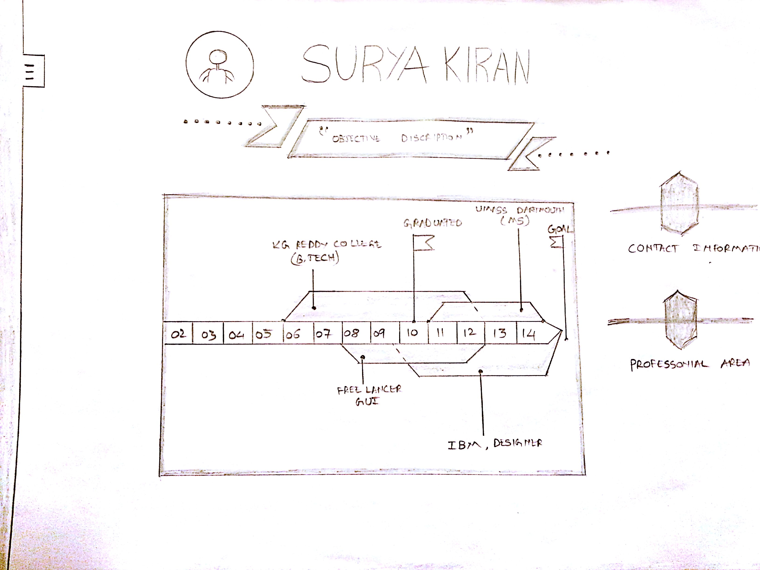
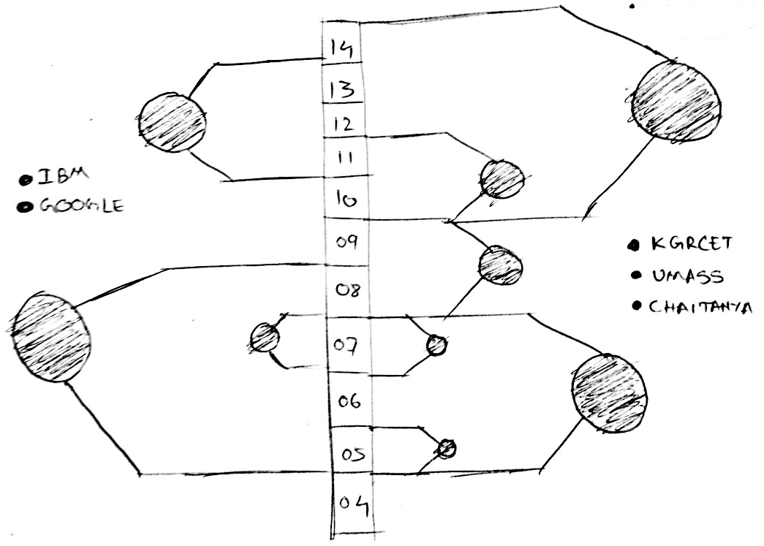

Slide 8
DATA
When we visit the website, at first the website will be like a template with pre populated sample fields. The user can then fill his fields on his own. In our project the data is taken from the user as an input & the program we design takes that input and represents that data in a graphical way.

Slide 9
Conclusion

Slide 10
Conclusion
We want to create a Resume which can be represented in a graphical way using data visualization techniques.

Slide 11
References
http://www.resumeup.com
http://bl.ocks.org/mbostock/3887193
http://www.pinterest.com/rtkrum/infographic-visual-resumes/
http://www.visualiza.me

Slide 12

Queries

Slide 13


